Slide 1



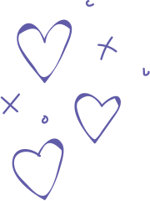





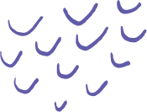





MINI PROJECT 2025
MACHINE
LEARNING

Slide 2
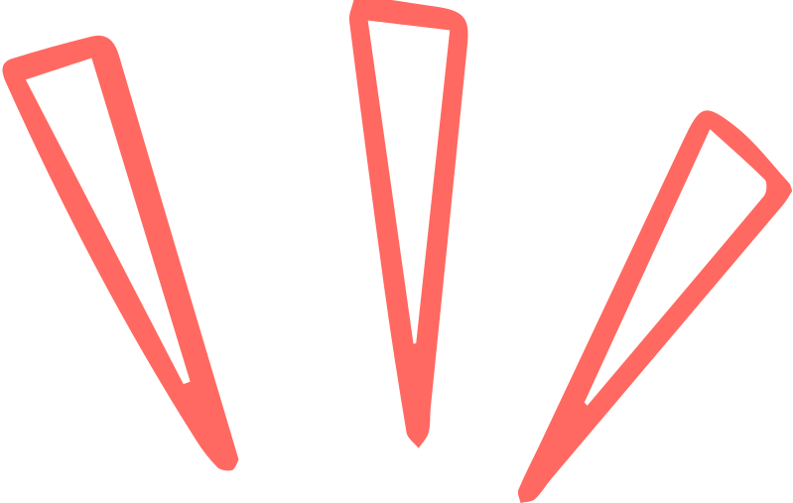
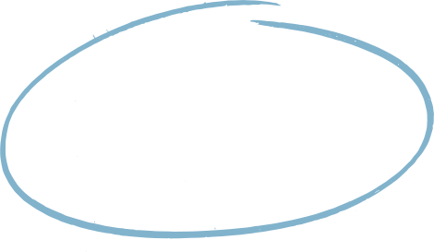


the project
Our project aims to build a real-time hand-drawn doodle recognition system that can identify what a user draws on a digital canvas. Using the DoodleNet pre-trained model, the system classifies sketches into one of 345 categories from the Google Quick, Draw! dataset.

Slide 3


PROBLEM STATEMENT
Recognizing hand-drawn sketches is challenging for machines due to variability in drawing styles, strokes, and abstraction levels.
Traditional image classifiers struggle with incomplete or imprecise sketches, making real-time doodle recognition a non-trivial task.
Our project addresses this by leveraging DoodleNet’s CNN architecture, which is specifically trained on millions of sketches.
The system provides accurate predictions in real time, enabling interactive applications such as educational tools, digital art interfaces, and AI-powered sketch recognition

Slide 4


Project Idea & objective
We aim to create an interactive web-based tool that allows users to draw freely on a canvas while the system predicts the object in real time. This demonstrates the ability of machine learning models to generalize across diverse doodle inputs.
The objective is to combine client-side ML, lightweight CNNs, and real-time inference to provide an engaging and educational experience. Users receive instant feedback on their sketches, highlighting the power of browser-based AI deployment.

Slide 5


KEY FEATURES
Interactive: Users can draw freely on a browser canvas.
Real-time Prediction: Model predicts the doodle instantly.
Browser-based: Runs entirely on the client side with no server required.
Educational & Fun: Can be used in learning apps, art projects, or interactive AI demos.

Slide 6


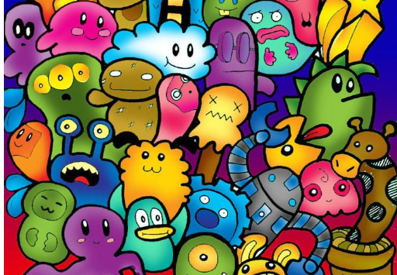
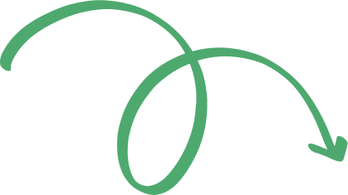

MODEL USED AND JUSTIFICATION
Our doodle classifier achieves high accuracy and precision because DoodleNet uses a CNN architecture, which automatically extracts spatial and hierarchical features from sketches. CNNs capture essential patterns like edges, curves, and strokes, enabling the model to distinguish even abstract or incomplete doodles effectively.
We chose CNN over traditional algorithms like SVM, k-NN, or Random Forests because they require manual feature engineering and perform poorly on variable sketch data. CNNs learn features directly from raw images, generalize better to unseen doodles, and support real-time, client-side inference, making them ideal for interactive web applications..

Slide 7
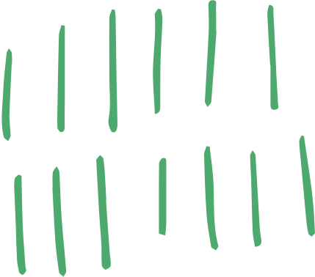

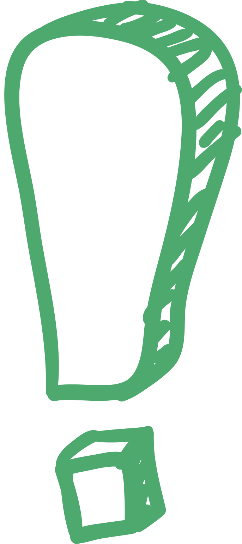

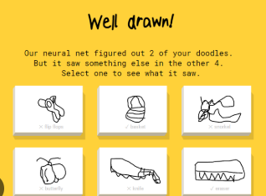
Dataset Used
We used the Google Quick, Draw! dataset, a large-scale collection of 50 million hand-drawn sketches spanning 345 categories such as animals, objects, and everyday items. Each sketch is represented as a 28x28 grayscale image, which is ideal for efficient CNN processing and ensures compatibility with DoodleNet’s architecture.
The dataset captures high variability in human drawing styles, including differences in stroke order, orientation, and abstraction. This diversity allows the model to learn robust feature representations, making it capable of recognizing sketches even when they are incomplete or stylized differently from standard forms.

Slide 8


methodology
Phase 1
Phase 3
MODEL SELECTION & LOADING
USER INTERACTION & INPUT CAPTURE
REAL-TIME CLASSIFICATION & DISPLAY
DATA ACQUISITION
Phase 2
Phase 4

Slide 9



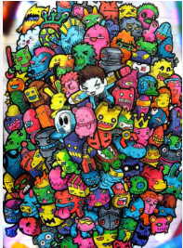

Technology
TOOLS & TECHNOLOGIES
MODEL DETAILS
The system is built with p5.js for drawing interactions and ml5.js to load the DoodleNet model. TensorFlow.js handles the CNN inference in the browser, while HTML/CSS/JS provides the frontend framework.
DoodleNet is a Convolutional Neural Network (CNN) pre-trained on Quick, Draw! data. It extracts spatial features from sketches and outputs top-5 predictions with confidence scores.
The model is optimized for lightweight inference in browsers, making it suitable for real-time, interactive doodle classification. Running entirely client-side ensures fast response times and scalability.
SYSTEM ARCHITECTURE
The workflow starts with the user drawing on a p5.js canvas, which is captured as an image. This image is passed to DoodleNet via ml5.js, producing top predictions with confidence scores. Results are then displayed dynamically on the interface.

